Slide 1
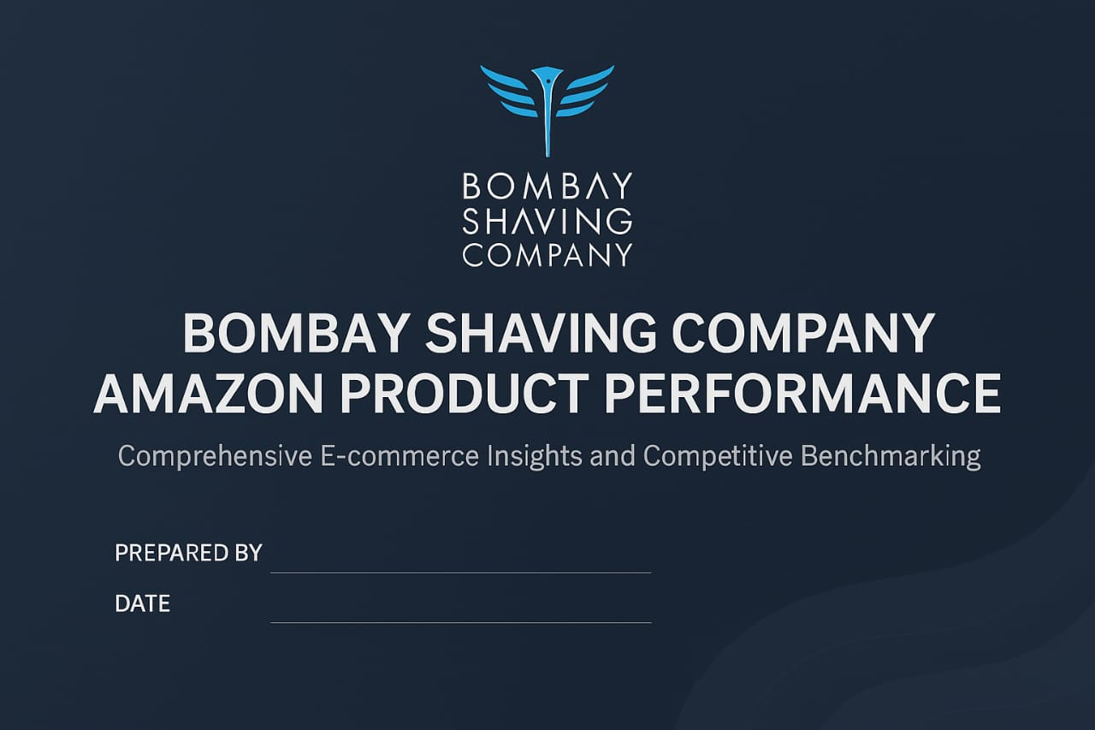
Vansh Suneja
18 APRIL 2025

Slide 2

CATEGORIZATION ANALYSIS
Category | Total_Reviews | Avg_Rating | Monthly_Sales
Shaving | 63732 | 3.8894736842105258 | 19650.0
Trimmer | 14320 | 3.96 | 17350.0
Face Wash | 6581 | 4.13238512966404 | 4324.0
Bath Soap | 4466 | 3.868246901312232 | 6628.0
Body Spray | 5583 | 4.106354039837974 | 5392.0
Hair Removal | 6405 | 3.7163279139209298 | 4607.0

Slide 3
HERO CATEGORY ANALYSIS
Key Insights
Shaving is BSC’s most reviewed and best-selling category — making it the volume hero.
Trimmers have fewer sales but a higher average rating, suggesting they’re high satisfaction, premium products.
These two categories account for over 75% of Amazon-estimated monthly volume — validating BSC’s category focus

Slide 4
TOP & BOTTOM PERFORMING PRODUCTS
TOP 5 BY SALES (Insight)
These top 5 products collectively account for 48.65% of monthly sales volume. They’re high-converting and well-rated — BSC should continue investing in their visibility (ads, Amazon’s Choice tags, influencer promos).
Title | Estimated Sales | Rating | Reviews Count
Bombay Shaving Company Beard Trimmer | 6000.0 | 4.0 | 9606
Bombay Shaving Company Power Play NXT Trimmer, | 5000.0 | 4.2 | 188
Bombay Shaving Company Power Play NXT Trimmer | 3000.0 | 4.1 | 1596
Bombay Shaving Company Sensi Smart 3 Value Pack | 2000.0 | 3.8 | 1082
Bombay Shaving Company Beard Pen Styler Razor | 2000.0 | 3.8 | 745

Slide 5
TOP & BOTTOM PERFORMING PRODUCTS
Title | Rating | Estimated Sales | Reviews Count
Bombay Shaving Company Post-Shave Balm, After-Shave | 4.4 | 400.0 | 159
Bombay Shaving Company Premium Shaving Kit For Men | 4.3 | 400.0 | 3351
Bombay Shaving Company Post-Shave Balm- After Shaving | 4.3 | 900.0 | 5015
Bombay Shaving Company Sensi Smart 3 Razor Cartridge | | 4.2 | 300.0 | 129
Bombay Shaving Company Classic Safety Razor | 4.2 | 700.0 | 123
TOP 5 BY RATING (Insight)
These top 5 products collectively account for 48.65% of monthly sales volume. They’re high-converting and well-rated — BSC should continue investing in their visibility (ads, Amazon’s Choice tags, influencer promos).

Slide 6
TOP & BOTTOM PERFORMING PRODUCTS
BOTTOM 5 PRODUCTS (Insight)
These 5 low-rated products have >100 reviews but <3.8 stars. This suggests quality or positioning issues. BSC could improve packaging, pricing, or bundle these in discounted kits to boost perception
Title | Rating | Estimated Sales | Reviews Count
Bombay Shaving Company Men Sensi Hair Removal | 3.2 | 100.0 | 210
Bombay Shaving company Deodorant Combo - (Lemon) | 3.6 | 1000.0 | 107
Bombay Shaving Company Premium Multi Grooming Trimmer for Men | 3.6 | 100.0 | 352
Bombay Shaving Company Perfume For Unisex | 3.6 | 400.0 | 339
Bombay Shaving Company Activated Charcoal Peel Off Mask | 3.8 | 1000.0 | 5661

Slide 7
Discount % vs. Monthly Sales: Correlation Analysis
Correlation Coefficient: -0.047
Interpretation: The correlation is very close to 0 and slightly negative.
Conclusion: Discounts are not strongly influencing monthly sales on Amazon for BSC.
Key Insight: Despite common perception, discounting doesn’t appear to significantly boost sales for BSC on Amazon.
Recommendation: BSC may benefit from bundling or brand positioning rather than relying heavily on discounts. Focus on product visibility, quality, and marketing.

Slide 8
AMAZON TAGS IMPACT ANALYSIS
Tags | Avg_Monthly_Sales | Avg_Rating | Avg_Review_Count
Prime | 1292.857142857143 | 3.7470588235294118 | 1635.235294117647
❌ No Tags | 609.6774193548387 | 3.9903225806451608 | 1621.0645161290322
Prime-tagged products sell significantly more but have slightly lower ratings.
Non-tagged products still perform well, indicating strong organic brand trust.

Slide 9
PRICE BAND SUMMARY ANALYSIS
KEY INSIGHTS
BSC’s mass-market strength lies in sub-₹600 pricing, which drives over 60% of estimated Amazon sales.
Mid-tier products (₹600–1K) underperform in customer ratings and need strategic attention.
High-end products, though well-rated, contribute minimally to volume — presenting an opportunity to reposition them as premium with better visibility or bundling.
.

Slide 10
CUSTOMER REVIEW ANALYSIS
KEY INSIGHTS
“While 63% of reviews reflect positive sentiment, nearly 1 in 4 customers express dissatisfaction — particularly around shaving product performance and perceived value. BSC could improve communication or formulation to reduce this negative cluster.”
Sentiment | Count | %
✅ Positive | 38 | 63%
😐 Neutral | 7 | 12%
❌ Negative | 15 | 25%

Slide 11
CUSTOMER REVIEW ANALYSIS
⚠️ Top Negative Themes:
• 'No foam in shaving cream' — product performance failure
• 'Disappointed… not worth cost' — perceived value issue
🔥 Top Positive Themes:
• 'Excellent product under ₹700' — pricing praise
• 'Design and performance is mind blowing' — BSC wins on aesthetics & experience

Slide 12
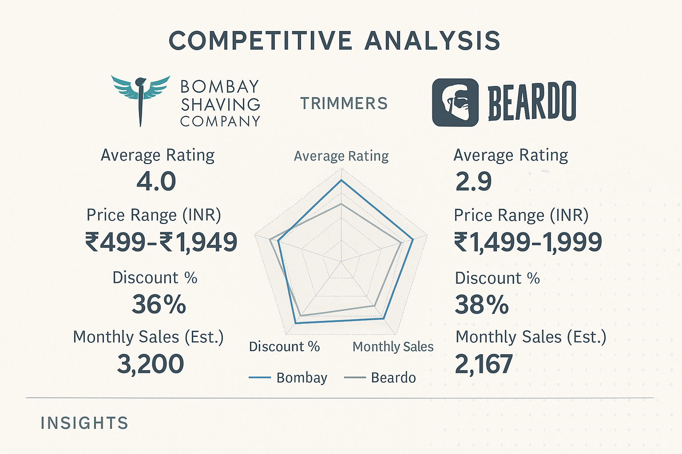
4.0
3.0
₹1320
₹1966
34.5%
43.2%
2414
750
Bombay Shaving Company leads the trimmer category on Amazon with ~10% lower prices, ⭐4.0 vs ⭐2.9 ratings, and 48% higher sales than Beardo — making it a trusted, value-for-money brand.

